Slide 1
Sorting and Hashing
See R&G Chapters: 9.1, 13.1-13.3, 13.4.2

Slide 2
Why Sort?
“Rendezvous”
Eliminating duplicates (DISTINCT)
Grouping for summarization (GROUP BY)
Upcoming sort-merge join algorithm
Ordering
Sometimes, output must be ordered (ORDER BY)
e.g., return results ranked in decreasing order of relevance
First step in bulk-loading tree indexes
Problem: sort 100GB of data with 1GB of RAM.
why not virtual memory?

Slide 3
Out-of-Core Algorithms
Two themes
Single-pass streaming data through RAM
Divide (into RAM-sized chunks) and Conquer

Slide 4

Single-pass Streaming
Simple case: “Map”.
Goal: Compute f(x) for each record, write out the result
Challenge: minimize RAM, call read/write rarely
Approach
Read a chunk from INPUT to an Input Buffer
Write f(x) for each item to an Output Buffer
When Input Buffer is consumed, read another chunk
When Output Buffer fills, write it to OUTPUT
Input
Buffer
Output
Buffer
INPUT
f(x)
OUTPUT
RAM

Slide 5
Better: Double Buffering pt 1
Main thread runs f(x) on one pair I/O bufs
2nd I/O thread drains/fills unused I/O bufs in parallel
Why is parallelism available?
Theme: I/O handling usually deserves its own thread
Main thread ready for a new buf? Swap!
Input
Buffers
Output
Buffers
INPUT
f(x)
OUTPUT
I/O
RAM

Slide 6
Better: Double Buffering pt 2
Main thread runs f(x) on one pair I/O bufs
2nd I/O thread drains/fills unused I/O bufs in parallel
Why is parallelism available?
Theme: I/O handling usually deserves its own thread
Main thread ready for a new buf? Swap!
Input
Buffers
I/O
Output
Buffers
INPUT
OUTPUT
f(x)
RAM

Slide 7
Double Buffering applies to all streams
Usable in any of the subsequent discussion
Assuming you have RAM buffers to spare!
But for simplicity we won’t bring this up again.
Input
Buffers
I/O
Output
Buffers
INPUT
OUTPUT
f(x)
RAM

Slide 8
Sorting & Hashing: Formal Specs
Sorting
Produce an output file F_{S}
with contents R stored in order by a given sorting criterion
Hashing
Produce an output file F_{H}
with contents R, arranged on disk so that no 2 records that have the same hash value are separated by a record with a different hash value.
I.e. matching records are always “stored consecutively” in F_{H}.
Given:
A file F:
containing a multiset of records R
consuming N blocks of storage
Two “scratch” disks
each with >> N blocks of free storage
A fixed amount of space in RAM
memory capacity equivalent to B blocks of disk

Slide 9
Sorting: 2-Way (a strawman)
Pass 0 (conquer a batch):
read a page, sort it, write it.
only one buffer page is used
a repeated “batch job”
Sort in place
I/O
Buffer
INPUT
INPUT
OUTPUT
OUTPUT
RAM
Notes:
5

Slide 10
Sorting: 2-Way (a strawman), cont
Pass 0 (conquer a batch):
read a page, sort it, write it.
only one buffer page is used
a repeated “batch job”
Pass 1, 2, 3, …, etc. (merge via streaming):
requires 3 buffer pages
note: this has nothing to do with double buffering!
merge pairs of runs into runs twice as long
a streaming algorithm, as in the previous slide!
Drain/fill buffers as the data streams through them
Output
Buffer
Input Buffer
INPUT
1
OUTPUT
3
2
Input Buffer
Notes:
5

Slide 11
Two-Way External Merge Sort
3,4
6,2
9,4
8,7
5,6
3,1
2
Input file
Conquer and Merge:
sort subfiles and merge
Each pass we read + write each page in file (2N)
N pages in the file.
So, the number of passes is:
So total cost is:
PASS 0
3,4
2,6
4,9
7,8
5,6
1,3
2
1-page runs
PASS 1
2,3
4,7
1,3
2-page runs
4,6
8,9
5,6
2
PASS 2
2,3
4,4
1,2
4-page runs
6,7
3,5
8,9
6
PASS 3
1,2
2,3
3,4
8-page runs
4,5
6,6
7,8
9
Notes:
6

Slide 12
General External Merge Sort
More than 3 buffer pages. How can we utilize them?
Big batches in pass 0, many streams in merge passes
To sort a file with N pages using B buffer pages:
Pass 0: use B buffer pages. Produce sorted runs of B pages each.
Pass 1, 2, …, etc.: merge B-1 runs at a time.
Pass 0
Pass 1, …
B
1
1
...
...
B-1
⌈N/B⌉
Conquer
Merge
Sorted Runs length B (last run’s length is variable)
Sorted Runs
Length B(B-1) (last run’s length is variable)
Notes:
7

Slide 13
Cost of External Merge Sort
Number of passes:
Cost = 2N * (# of passes)
E.g., with 5 buffer pages, to sort 108 page file:
Pass 0: = 22 sorted runs of 5 pages each
last run is only 3 pages
Pass 1: = 6 sorted runs of 20 pages each
last run is only 8 pages
Pass 2: 2 sorted runs, 80 pages and 28 pages
Pass 3: Sorted file of 108 pages
Formula check: 1+┌log₄ 22┐= 1+3 → 4 passes √
Notes:
8

Slide 14
# of Passes of External Sort
( I/O cost is 2N times number of passes)
Notes:
9

Slide 15
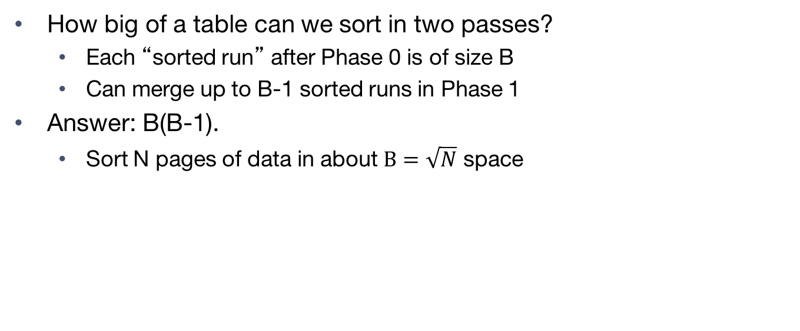
Memory Requirement for External Sorting
How big of a table can we sort in two passes?
Each “sorted run” after Phase 0 is of size B
Can merge up to B-1 sorted runs in Phase 1
Answer: B(B-1).
Sort N pages of data in about $B=\sqrt{N}$ space
Pass 0
Pass 1, …
B
1
1
...
...
B-1
⌈N/B⌉
Conquer
Merge
Sorted Runs length B (last run’s length is variable)
Sorted Runs
Length B(B-1) (last run’s length is variable)

Slide 16
Alternative: Hashing
Idea:
Many times we don’t require order
E.g.: removing duplicates
E.g.: forming groups
Often just need to rendezvous matches
Hashing does this
But how to do it out-of-core??

Slide 17
Divide
Streaming Partition (divide): Use a hash function h_{p} to stream records to disk partitions
All matches rendezvous in the same partition.
Each partition a mix of values
Streaming alg to create partitions on disk:
“Spill” partitions to disk via output buffers

Slide 18
Conquer
ReHash (conquer): Read partitions into RAM hash table one at a time, using hash f’n h_{r}
Each bucket contains a small number of distinct values
Then read out the RAM hash table buckets and write to disk
Ensuring that duplicate values are contiguous

Slide 19
Two Phases: Divide
Partition: (Divide)
Original
Relation
OUTPUT
Partitions
1
1
INPUT
2
hash
function
h_{p}
2
. . .
B-1
B-1
B main memory buffers

Slide 20
Two Phases: Conquer
Rehash: (Conquer)
Hash partitions h_{p} of size ~N/(B-1)
Output
Relation
Partitions
Hash table for partition
R_{i} (k <= B pages)
hash
function
h_{r}
Hash partitions hp of size ~N/(B-1)
B main memory buffers
Hash partitions hr Fully hashed!

Slide 21
Cost of External Hashing
Divide (h_{p})
Conquer (h_{r})
1
…
B
B-1
Hash partitions hp of size ~N/(B-1)
Hash partitions hr
Fully hashed!
cost = 2*N*(#passes) = 4*N IO’s (includes initial read, final write)

Slide 22
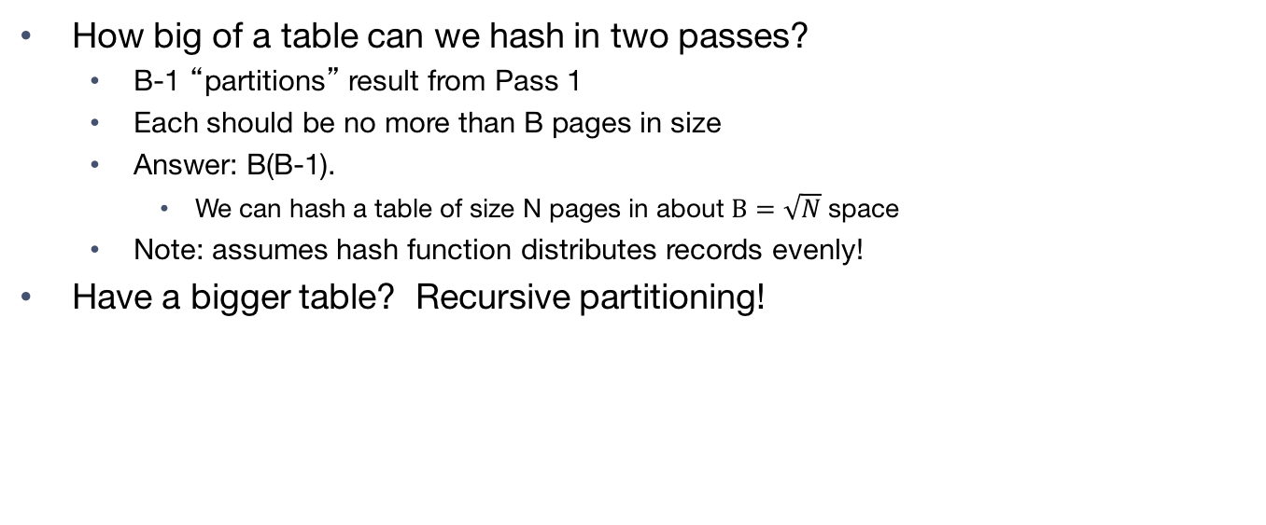
Memory Requirement
How big of a table can we hash in two passes?
B-1 “partitions” result from Pass 1
Each should be no more than B pages in size
Answer: B(B-1).
We can hash a table of size N pages in about $B=\sqrt{N}$space
Note: assumes hash function distributes records evenly!
Have a bigger table? Recursive partitioning!
Divide (h_{p})
Conquer (h_{r})
1
B
…
B-1
Hash partitions hr
Fully hashed!
Hash partitions hp of size ~N/(B-1)

Slide 23
Recursive Partitioning, Pt 1
Divide (h_{p})
Divide (h_{p1})
B big!

Slide 24
Recursive Partitioning, Pt 2
Divide (h_{p})
Conquer (h_{r})
Divide (h_{p1})
B big!

Slide 25
Recursive Partitioning, Pt 3
Divide (h_{p})
Divide (h_{p1})
Conquer (h_{r})
B big!
B big!

Slide 26
A Wrinkle: Duplicates
Consider a dataset with a very frequent key
E.g. in a big table, consider the gender column
What happens during recursive partitioning?
Divide (h_{p})
Divide (h_{p1})
M
F
M
other

Slide 27
Question…
How does external hashing compare
with external sorting?

Slide 28
Cost of External Hashing
Divide
Conquer
cost = 4*N IO’s (including initial read, final write)

Slide 29
Cost of External Sorting
Conquer
Divide
cost = 4*N IO’s (including initial read, final write)

Slide 30
Parallelize me! Hashing Phase 1
Phase 1: shuffle data across machines (hn)
streaming out to network as it is scanned
which machine for this record? use (yet another) independent hash function hn
h_{n}

Slide 31
Parallelize me! Hashing Phase 2
Phase 1: shuffle data across machines (hn)
Receivers proceed with phase 1as data streams in
from local disk and network
h_{p}
h_{r}
h_{n}

Slide 32
Parallelize me! Sorting
Pass 0: shuffle data across machines
streaming out to network as it is scanned
which machine for this record? Split on value range (e.g. [-∞,10], [11,100], [101, ∞]).
range

Slide 33
Parallelize me! Sorting, cont
Pass 0: shuffle data across machines
Receivers proceed with pass 0as the data streams in
A Wrinkle: How to ensure ranges are the same #pages?!
i.e. avoid data skew?
range

Slide 34
So which is better ??
Simplest analysis:
Same memory requirement for 2 passes
Same I/O cost
But we can dig a bit deeper…

Slide 35
Sorting vs Hashing
Hashing pros:
For duplicate elimination, scales with # of values
Delete dups in first pass while partitioning on hp
Vs. sort which scales with # of items!
Easy to shuffle equally in parallel case
Sorting pros:
Great if we need output to be sorted anyway
Not sensitive to duplicates or “bad” hash functions

Slide 36
Summary
Sort/Hash Duality
Hashing is Divide & Conquer
Sorting is Conquer & Merge
Sorting is overkill for rendezvous
But sometimes a win anyhow
Don’t forget one pass streaming and double buffering
Can “hide” the latency of I/O behind CPU work

